Slide 1
Stack Implementation Using a Linked List
Prepared By:
Abdulrahman Abdulkader
Muhammad Addali
Issam Al-Maarouf
Abdulaziz Haji Bakour
Majed Assayed
Course: Data Structures & Algorithms
Instructor: Firas Khalil
Sham University
2025/2026

Slide 2
What is a Stack?
A stack is a linear data structure where all the elements in the stack can insert and delete from one side only rather than at the middle or from both the sides.
In other words, stacks are last-in first-out (or LIFO) structures.
The last-added element into a stack is called the “top” element, which we use as a reference to perform stack operations.

Slide 3
Stack Data Structure
Element 4
top
Element 3
Element 2
Element 1

Slide 4
Why stacks are important:
Web browsers utilize stacks to keep track of the user's navigation history, enabling the 'Back' button functionality
Operating systems leverage stacks for managing process execution and tracking nested function calls.
Stacks are widely used for expression evaluation, such as Balanced Parenthesis.

Slide 5
Stack Operations:
Push: to add an element on top of the stack.
Pop: to remove the top element of the stack and return its value.
getTop: to return the top element of the stack.
isEmpty: to check whether the stack is empty or not.

Slide 6
How Is Stack Data Structure Implemented in Memory?
There are two ways to represent a stack in memory: One way is using an array, and the other is using a linked list.

Slide 7
Array-based Stack
An array-based stack implementation involves using a static or dynamic array. This method relies on static memory allocation, meaning the size of the stack is fixed and cannot be changed.
The advantage of This method is that it’s fast and efficient, and the time complexity for all stack operations is O(1).
The disadvantages of this method is that arrays use static memory allocation, which might cause stack overflow (if using static arrays), and it can be costly (if using dynamic arrays) due to new memory allocation and copying existing elements.

Slide 8
Array-based Stack
Let’s say we have a stack based on an array.
Let’s call it “Stack_1”.
Stack_1
10
5
4
empty
Suppose that our array has a capacity of
4 elements.
Stack_1.Push(10);
Stack_1.Push(5);
Stack_1.Push(4);
(top)
Index: 0
Index: 1
Index: 2
Index: 3
The fact is that extra slots may be created, whether we pushed elements into the stack or not.
For that reason, and in order to solve that extra memory-usage issue, we’re going to use a Linked-list instead of an array.
ONLY ONE contiguous block of memory

Slide 9
Linked-list based Stack
This stack is implemented using a linked list. Each node holds two parts: the data element and a pointer to the next node.
The data element holds the value we are going to store in our stack.
The pointer stores the location of the next node in memory.
In stacks, we use a Singly-linked List, which is unidirectional. Therefore, we can only move forward through our nodes.
The last-added node, which holds the top element, is not followed by any node; So the pointer it stores will have a value of NULL.

Slide 10
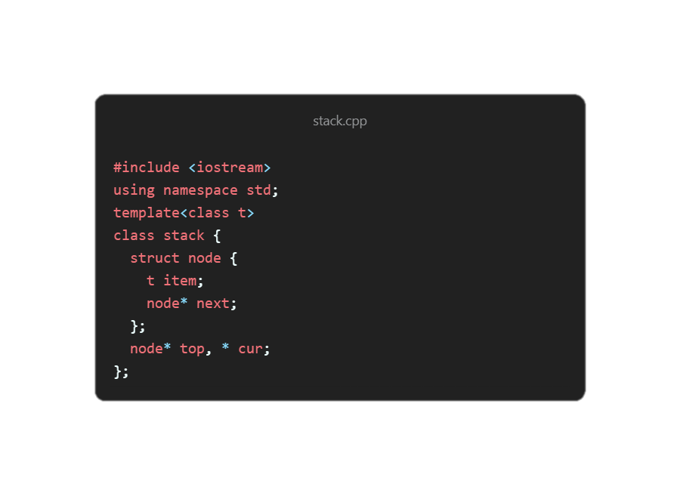
Linked-list based Stack
Now, we will implement the stack data structure using a linked list.
First, we define the stack class.
As we mentioned earlier, a stack is composed of nodes. Each node contains a data item and a pointer.
To represent this, we define a struct with two members:
  item – a variable that stores the data
  next – a pointer to the next node in the stack
To make the stack generic and able to store any data type, we use templates for the item.
We will also define two pointers: cur, which we will to loop through the stack, and top, which refers to the top item of the stack.

Slide 11
Linked-list based Stack
When a new stack object is created, it contains no elements.
Therefore, the top pointer is initialized to nullptr, indicating that the stack is empty.
stack() {
top = nullptr;
}
Since an empty stack has its top pointer set to nullptr, we can implement the isEmpty() function to check this value and determine whether the stack contains any elements.
bool isEmpty() {
return top == nullptr;
}

Slide 12
push()
Linked-list based Stack
The constructor initializes a new, empty stack. Since we haven’t yet pushed any item into the stack, it has only one pointer of type node; the top pointer.
The top pointer’s initial value is set to nullptr
push(newItem)
New Item
When push(newItem) is called:
A new item node is created
A pointer to the new item node is defined.
add to stack
next = top
top = newItemPtr
*top
(nullptr)
New Item
The new node’s next pointer is set to the previous top, and then the previous top is set to the new item pointer.
Stack

Slide 13
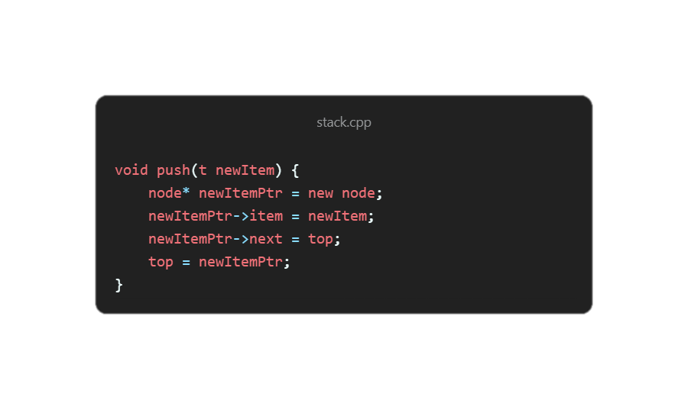
push()
Linked-list based Stack

Slide 14
push()
Linked-list based Stack
Push(50)
add
50
50
to
top
next
node* newItemPtr = new node;
newItemPtr->item = newItem;
newItemPtr->next = top;
top = newItemPtr;
10
10
top
next
next
40
40
next
next
30
30
next = nullptr
next = nullptr

Slide 15
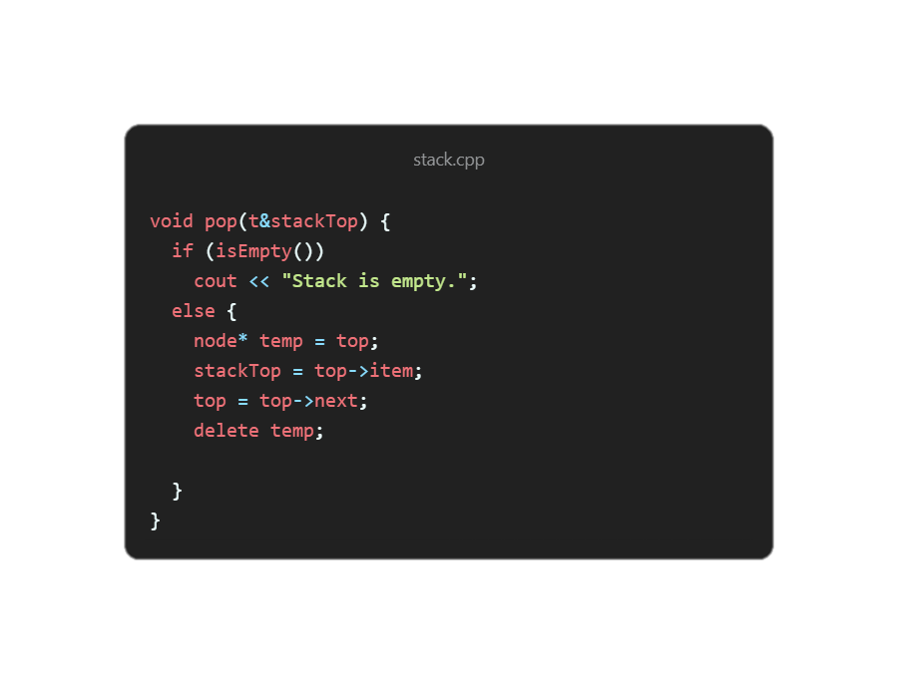
pop()
Linked-list based Stack
The pop() function removes the top element from the stack and returns its value.
How it works:
First, the function checks if the stack is empty using isEmpty().
If it is empty, a message is displayed.
If the stack is not empty:
  A temporary pointer temp is set to the current top node.
  The value stored in top is saved into stackTop.
  The top pointer is moved to the next node.
  The old top node is deleted from memory.

Slide 16
pop()
Linked-list based Stack
50
top
next
10
10
node* temp = top;
top = top -> next;
delete temp;
top
next
next
40
40
next
next
30
30
next = nullptr
next = nullptr

Slide 17
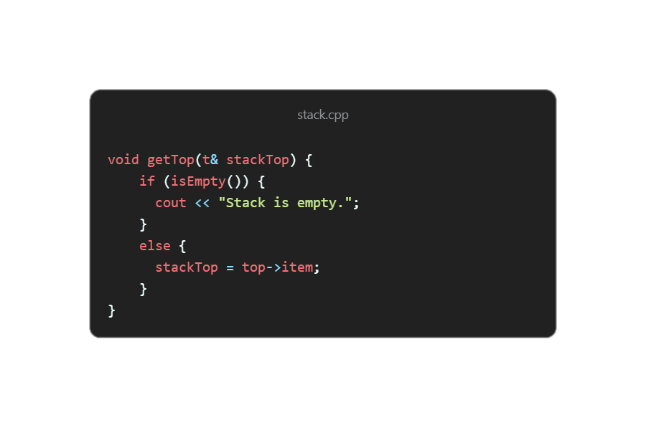
getTop()
Linked-list based Stack
The getTop() function returns the value of the top element without removing it from the stack.
How it works:
It first checks whether the stack is empty using isEmpty().
If the stack is empty, a message is displayed.
Otherwise, the value stored in the top node is copied into stackTop.
This operation allows us to peek at the top element while keeping the stack unchanged.

Slide 18
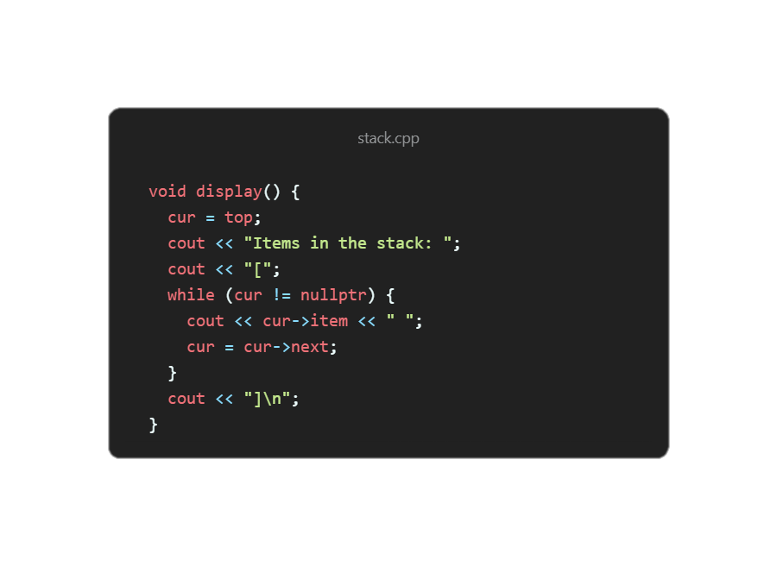
display()
Linked-list based Stack
The display() function prints all the elements currently stored in the stack.
How it works:
A pointer cur is initialized to the top of the stack.
The function starts from the top node and traverses the linked list.
In each step, it prints the item stored in the current node.
The pointer moves to the next node until it reaches nullptr, which marks the end of the stack.
This displays the stack contents from top to bottom.
Time Complexity:
The display() operation runs in O(n) time, where n is the number of elements in the stack.

Slide 19
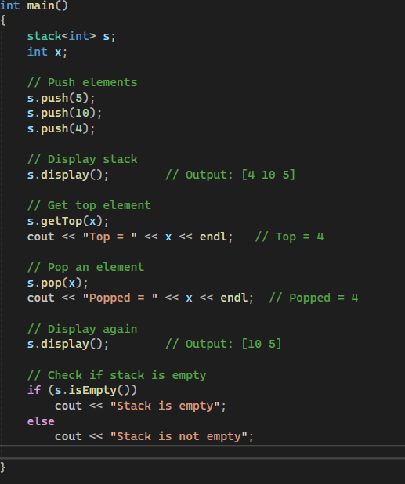
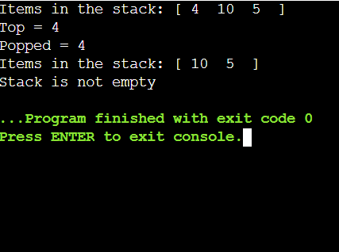
Example usage

Slide 20
Final Notes
This project demonstrated the implementation of a stack using a linked list, supporting operations such as push, pop, getTop, and display.
Compared to an array-based stack, the linked list implementation provides dynamic memory allocation, eliminating overflow and allowing the stack to grow as needed.
This design ensures constant-time (O(1)) performance for insertion and removal, making it efficient for real-world applications such as function calls, expression evaluation, and memory management.

Slide 21
Source Code
https://github.com/blastille/DSA-Implementations/blob/main/stack_linked_lists.cpp

